Slide 1




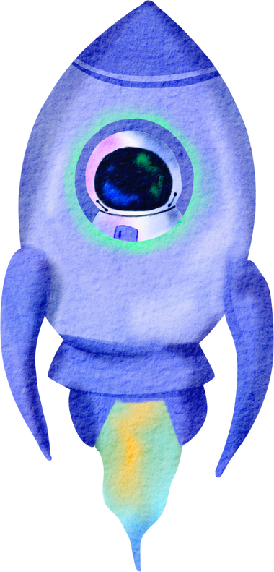



SAN ACADEMY VELACHERY
INTRA COMPETITION
APRIL MONTH
TOPIC : COSMIC WONDER

Slide 2

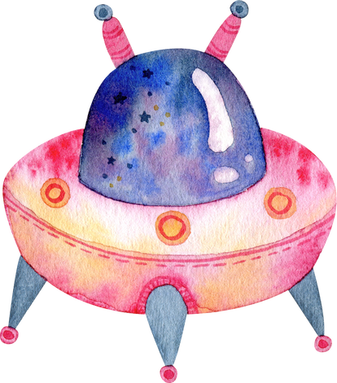



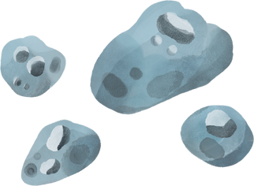
CLASS I
TOPIC : COLOUR BLAST
DATE : 9/4/25
DURATION : 60 MINS
Rules and Materials Required:
  Activity sheet will be provided
  Child must bring required colouring materials(crayons /colour pencils)
Judging criteria
  Creativity
  Neatness
  Colour scheme
  Overall presentation
Note: Judges decision is final

Slide 3
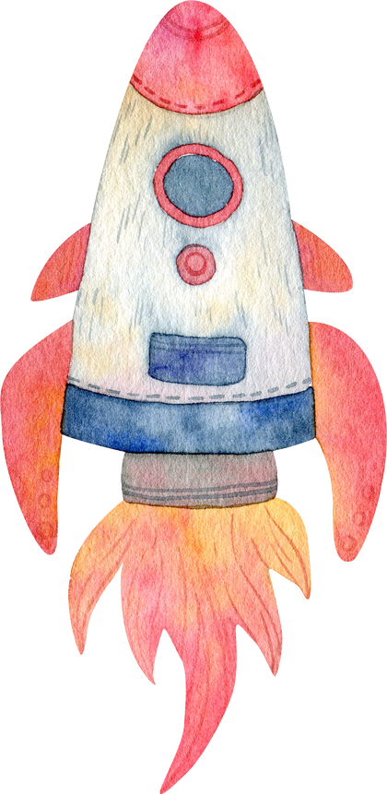

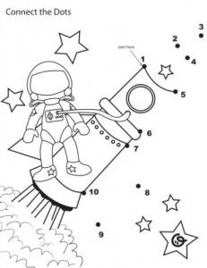
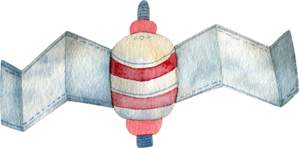

CLASS II
TOPIC : CONNECT THE DOT
DATE : 9/4/25
DURATION : 60 MINS
Rules and Materials Required:
  Activity sheet will be provided
  Student must join the dots and colour the picture .
  Child must bring pencil and required colouring material(crayons /colour pencils)
Judging criteria
  Creativity
  Neatness
  Colour scheme
  Overall presentation
Note: Judges decision is final

Slide 4
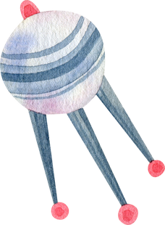

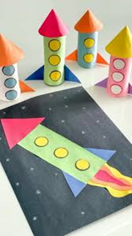
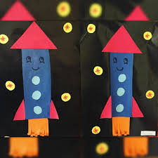
CLASS III
TOPIC : DIY 2D or 3D PAPER ROCKET CRAFT
DATE : 10/4/25
DURATION : 60 MINS
Rules and Materials Required:
  Colour A4 sheet(any colour) / color chart paper/foam sheet/tissue roll can be used.
  You may bring theme-related decorating materials such as stickers, printouts, and cutouts to enhance your design.
  Craft adhesive glue
  Ensure to bring child-safe scissors, as hazardous scissors are not allowed.
Judging criteria
  Creativity
  Aesthetic look
  Color combination
  Choices of materials
Note: Judges decision is final

Slide 5



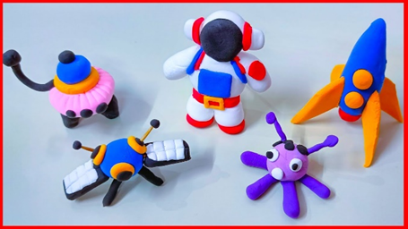

CLASS IV
TOPIC : CLAY MODELLING - MINIATURE
DATE : 11/4/25
DURATION : 60MINS
Rules and Materials Required:
  Any 4 cosmic structures (natural or manmade) to be made.
  Clay dough
Judging criteria
  Creativity
  Theme interpretation
  Craftmanship
  Overall presentation.
Note: Judges decision is final

Slide 6





CLASS V
TOPIC : CELESTIAL PAPER SPACE THEME WREATH
DATE : 8/4/25
DURATION : 60 MINS
Rules and Materials Required:
  Using paper plate or colour chart/paper
  You may bring theme-related decorating materials such as stickers, printouts, and cutouts to enhance your design.
  Craft adhesive glue
  Ensure to bring child-safe scissors, as hazardous scissors are not allowed.
Judging criteria
  Creativity
  Theme interpretation
  Craftmanship
  Overall presentation.
Note: Judges decision is final

Slide 7

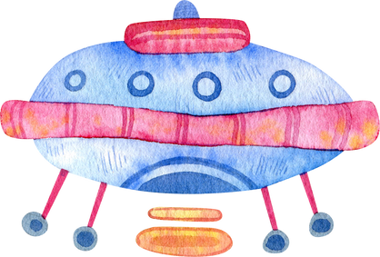
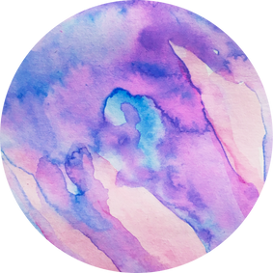


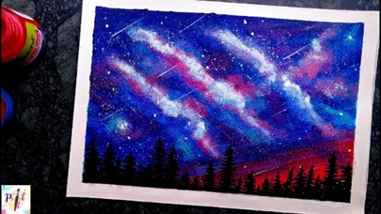





CLASS VI & VII
TOPIC : POSTER MAKING - GALAXY NIGHT SKY
DATE : 16/4/25
DURATION : 40 MINS
Rules and Materials Required:
  ¼ size chart or A4 sheet
  Colour pencils, Art Pencils, crayons, acrylic paint can be used.
  Any appropriate Art materials can be used.
Judging criteria
  Creativity
  Theme interpretation
  Complexity and Neatness
  Colour scheme, Layout.
Note: Judges decision is final

Slide 8
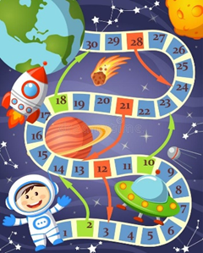
CLASS VIII & IX
TOPIC : DESIGNING SPACE THEMED BOARD GAME
DATE : 16/4/25
DURATION : 40 MINS
Rules and Materials Required:
  Can bring any appropriate material to assemble.
  The game has to be demonstrated.
Judging criteria
  Creativity
  Theme interpretation
  Composition and Design
  Demonstration
Note: Judges decision is final

Slide 9


CLASS X
DURATION : 40 MINS
TOPIC : POSTER MAKING- SUNITA WILLIAMS EARTH RETURN SUCCESS SPACE MISSION
DATE : 16/4/25
Rules and Materials Required:
  A4 size sheet or ¼ size chart
  You may bring theme-related decorating materials such as stickers, printouts, and cutouts to enhance your design.
  Craft adhesive glue
  Ensure to bring child-safe scissors, as hazardous scissors are not allowed.
  Title/caption to be given with quote appropriate to the theme.
Judging criteria
  Creativity
  Title/caption
  Content
  Writing style and Presentation
Note: Judges decision is final

Slide 10







